Slide 1
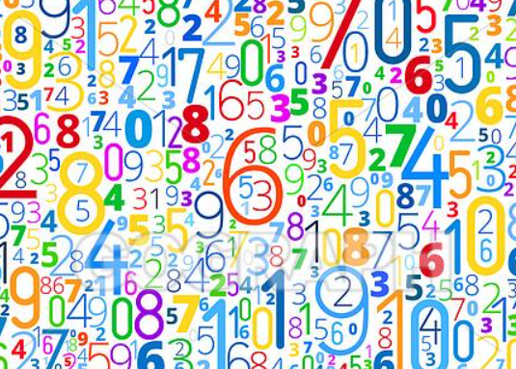
Maths Workshop
The Horsell Village School
November 2024

Slide 2
Th
The aims of this presentation are to share with you :
The aims of the Maths National Curriculum.
What does Maths look like at HVS?
Developing Number sense.
The 3 spines of Maths Mastery.
What else do we teach in Maths?

Slide 3
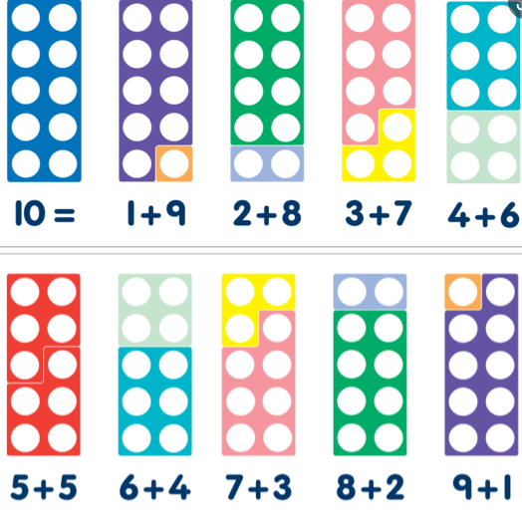
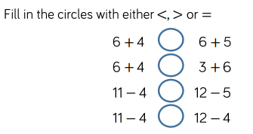
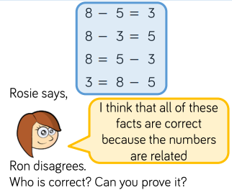
Th
The three aims of the maths curriculum are:
Number fluency Problem Solving Reasoning
Our Maths lesson will have an element of all 3 aims within it.
We teach through Maths Mastery, following White Rose Education and supported by the National Centre for Excellence in the Teaching of Mathematics (NCETM).

Slide 4
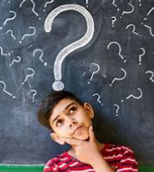
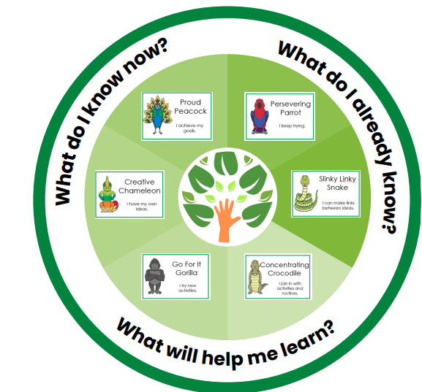
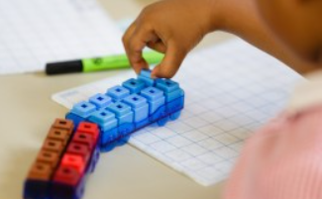
Mat-This sequence of
What does a Maths lesson look like?
Questioning is a key part of Maths. The teacher will ask key questions designed to prompt investigation and exploration.

Slide 5
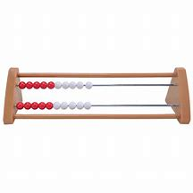
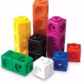
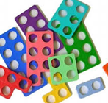
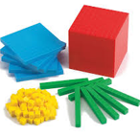
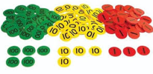
What do we do to help children achieve mastery?
We teach children how to use a variety of manipulatives. Once a child has mastered the key mathematical ideas using the manipulatives, they remain accessible. The children can then choose their preferred choice of learning, being concrete (manipulatives), pictorial or abstract, and return to use the manipulatives at any point in their exploration, should they feel that it will enhance their learning.

Slide 6
What do we do to help children achieve mastery?
Concrete
(Physical Objects)
Pictorial
(Drawings/Models)
Abstract
(Using numbers)
1
2
3
4
Concrete and pictorial
representations support
children to understand abstract
concepts and deepen
their knowledge.

Slide 7
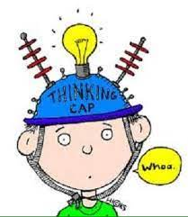
The starting point…. Number Fluency- Developing number sense
So….. What is number sense and why is it so important
Number sense refers to a child’s fluidity and flexibility with numbers.
It helps children understand what numbers mean, increasing
mental mathematics and giving children the tools to look at maths in the outside world and make comparisons.
Children develop a number sense gradually over time through exploring numbers, visualising them in a variety of contexts and relating them in ways that are not limited by formal written methods.
Number sense is the main focus on the Early Years Curriculum however forms an essential part of fluency for all year groups.
So … where does it all begin and how do we support and plan for progression in number sense here at school?

Slide 8
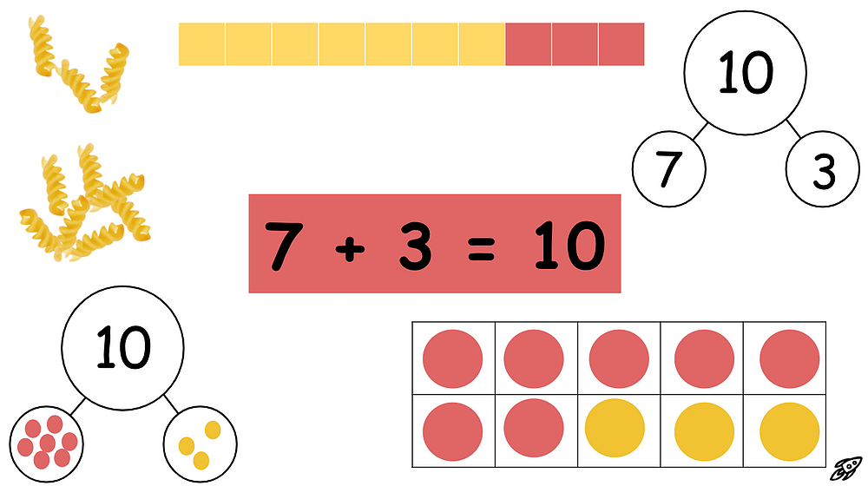
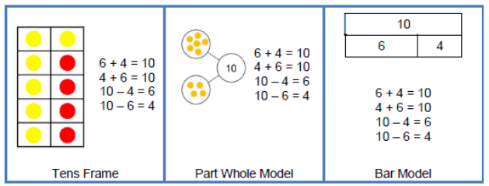
Th
Same concept in different ways:

Slide 9
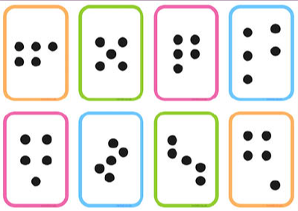
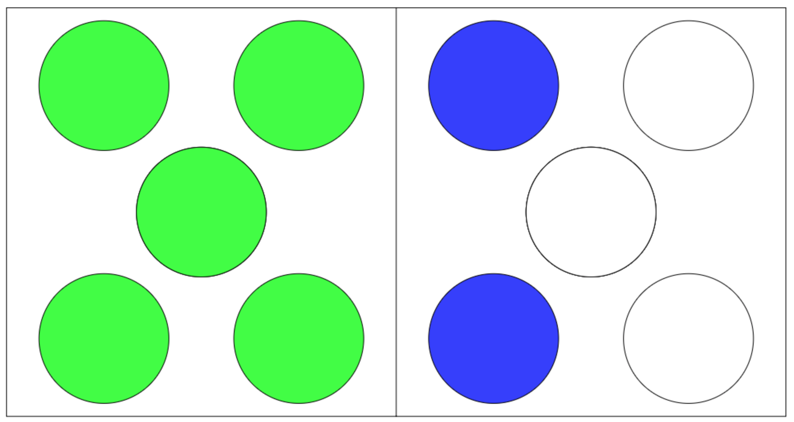
How do we help develop Number sense?
Subitising
Don’t count, say the amount.
Children need a variety of opportunities to see regular amounts of quantities and be encouraged to ‘say what they see.’
These regular amounts also need to be shown in irregular ways:
* conceptual subitising
(seeing smaller numbers)
* perceptual subitising
(seeing numbers straight away)

Slide 10
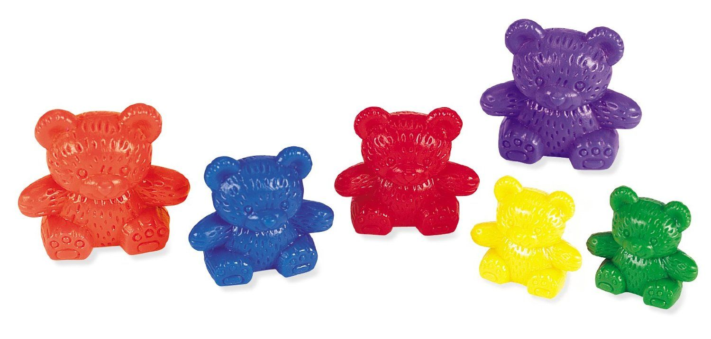
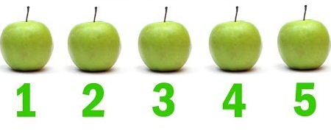
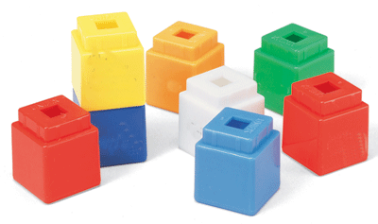
How do we help develop Number sense?
Counting
3 rules of counting
1.Count everything once
2. Say the numbers in the right order
3. The last number you say is how many there are
1:1 correspondence

Slide 11
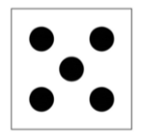
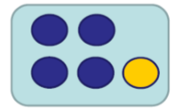
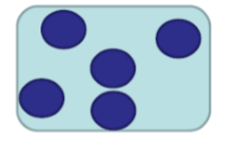
How do we help develop Number sense?
Cardinality
Cardinality means the quantity or total number of items in a set.
This can be determined by subitising or counting.
While subitising allows children to perceive the cardinality of small sets, counting requires them to understand that the last number in the counting sequence represents the quantity of the set. We refer to this as….
‘The 5-ness of 5’
Subitising – is the process of immediately knowing how many objects are in a small group without needing to count them.
Familiar and structured dot patterns | Structure dot patterns | Unstructured dot patters

Slide 12
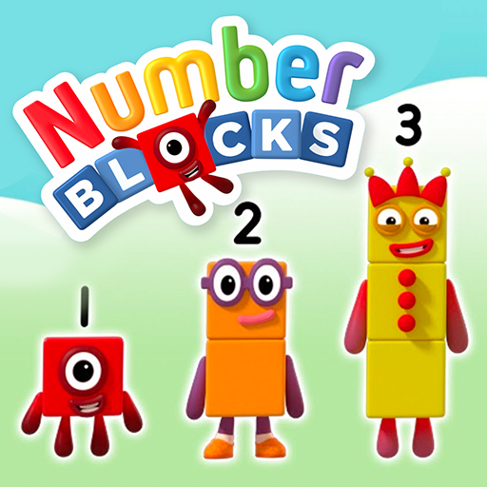
1 is a part and 4 is a part
How do we help develop Number sense?
Composition
Composition refers to part part whole relationships. This is often referred to as the ‘hidden numbers’ with a number, ie: understanding that the number 5 can have several different parts in its composition.
For example
. 5 is the whole
2 is a part and 3 is a part
4 is a part and 1 is a part
5 is the whole
Being able to see numbers within numbers helps to develop efficient calculating skils

Slide 13
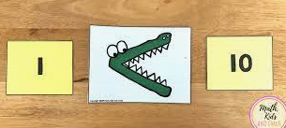
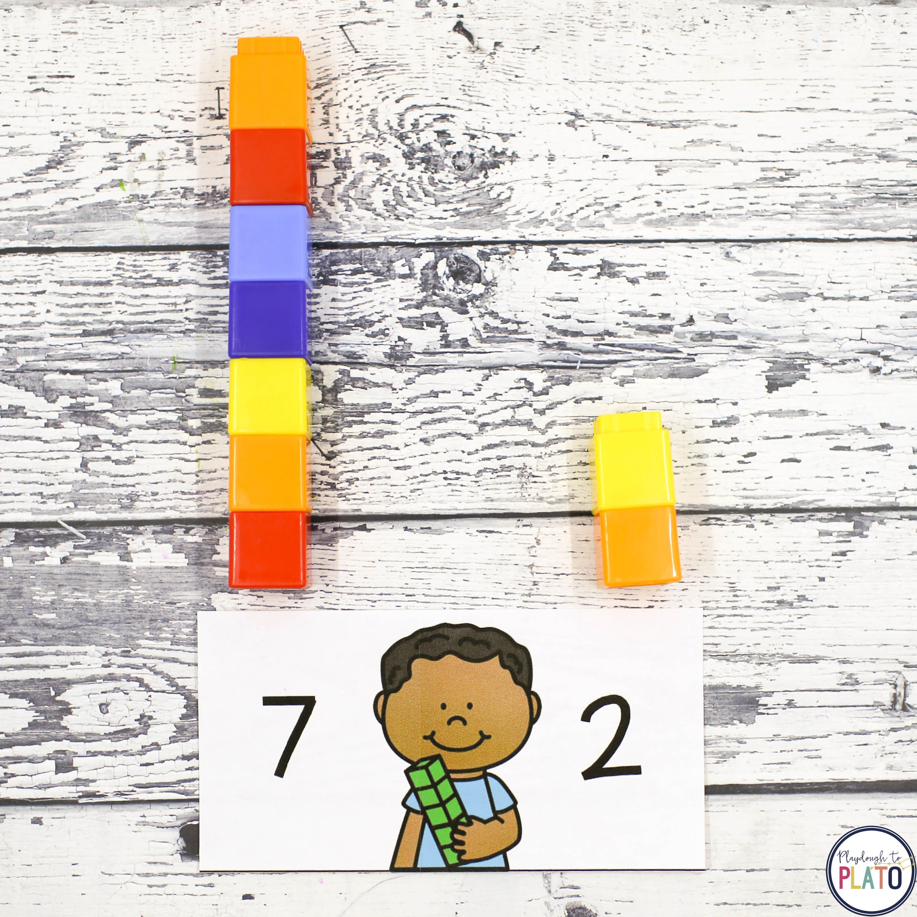
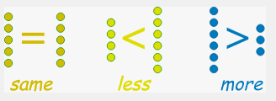
1 is a part and 4 is a part
How do we help develop Number sense?
Comparison
When we ask children to compare numbers we are asking them to examine the difference, to decide if one number is greater than, smaller than or equal to another number.
5
8

Slide 14
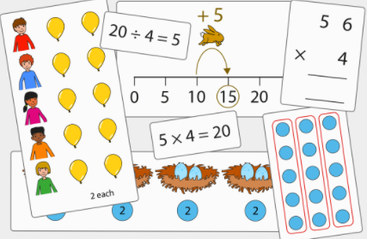
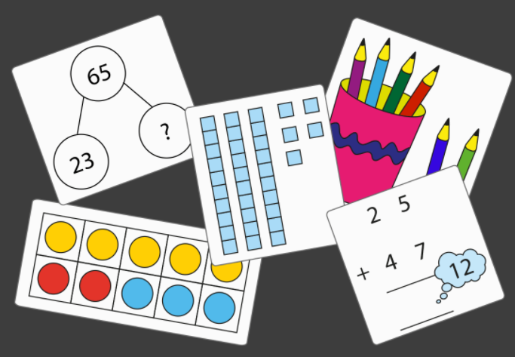
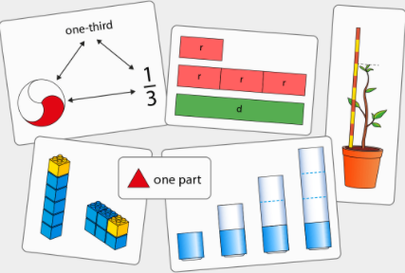
Primary Maths Mastery is based on 3 main ‘spines’
This is a carefully sequenced progressive journey including:
Number, addition and subtraction
Whole and parts
Composition of starting at 0-5 and building gradually up to 100
Addition and subtraction strategies initially within 10 and then bridging 10
Addition and subtraction of 1 digit and 2 digit numbers, extending to 2 digit and 2 digit numbers.
Multiplication and division
Counting and unitising (counting groups rather than individual items, for example egg boxes, rather than individual eggs).
Times tables : groups of 2s, 5s and 10s and commutativity
Doubling and halving
Division: sharing and applying knowledge of multiplication to solve grouping problems.
Fractions
Recognising and finding fractions of an object, shape and quantity, relating fractions of a quantity to previously taught division.

Slide 15
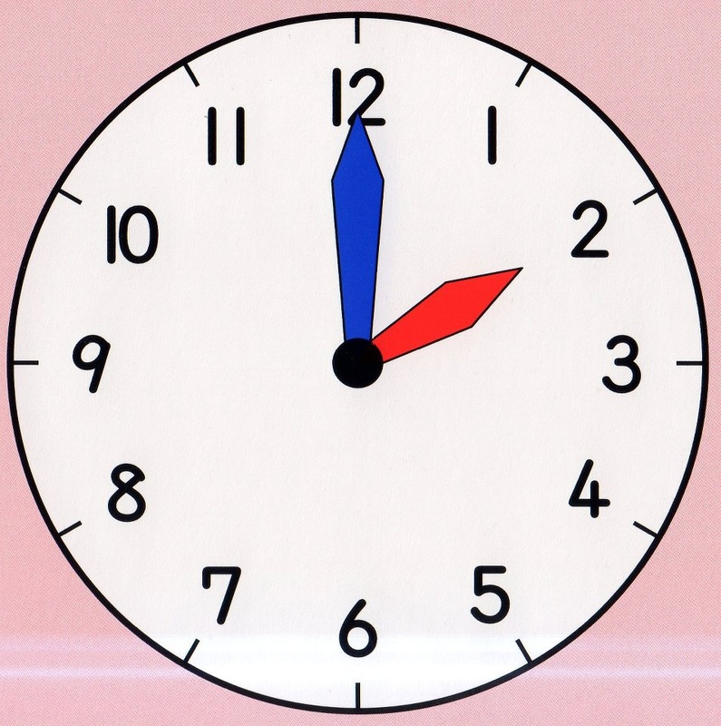
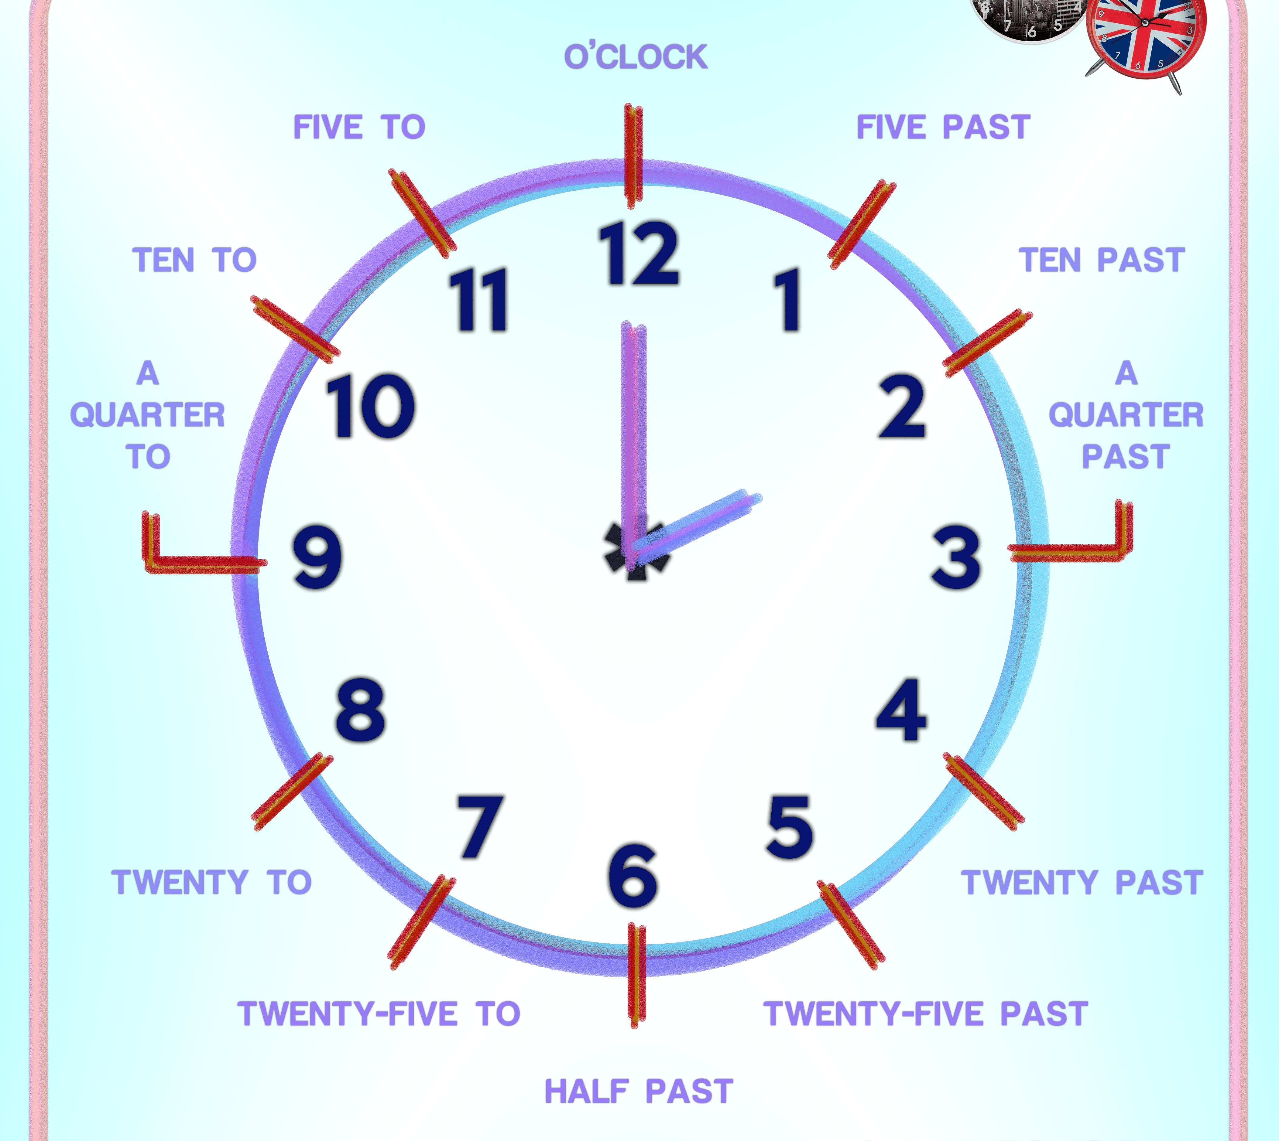
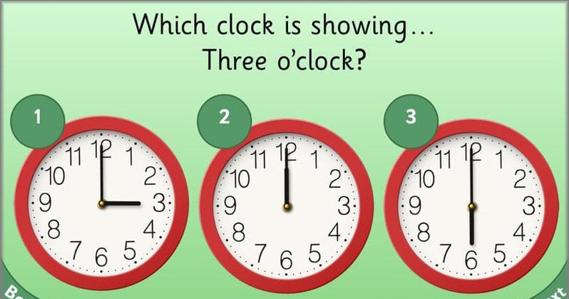
1 is a part and 4 is a part
What else do we teach in Maths?
Time
We look at the names of the ‘hands’ and how they move. We discuss o’clock and half past the hour. In year 2 we look at telling the time using ¼ past and ¼ to the hour as well as 5 minute intervals.

Slide 16
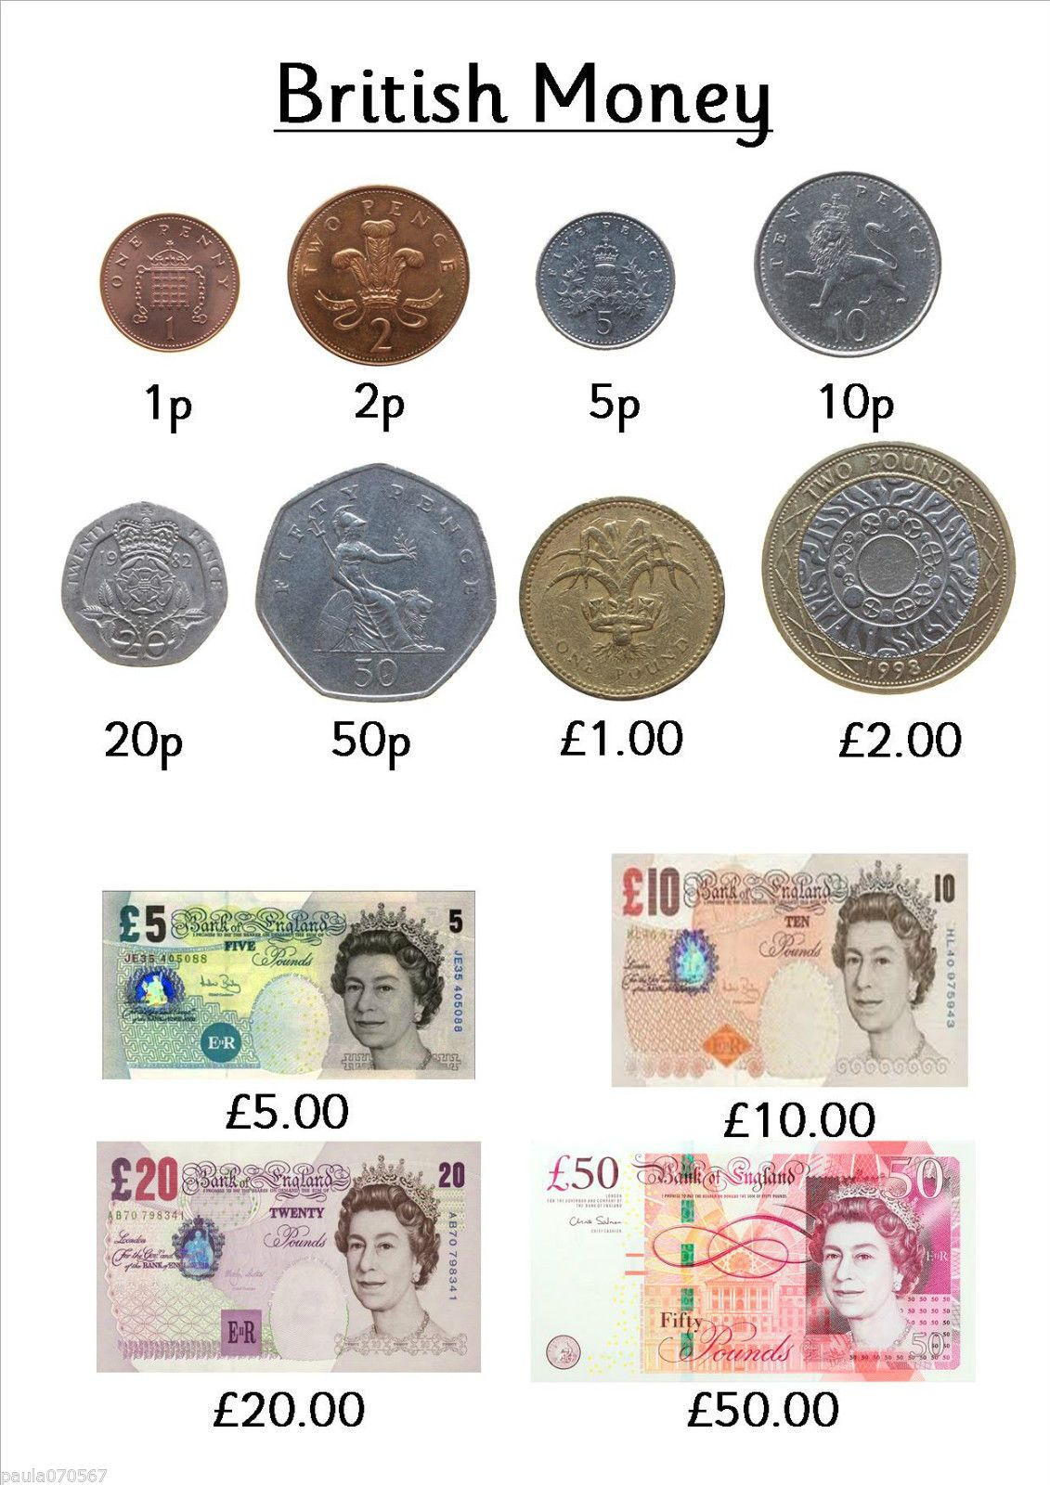
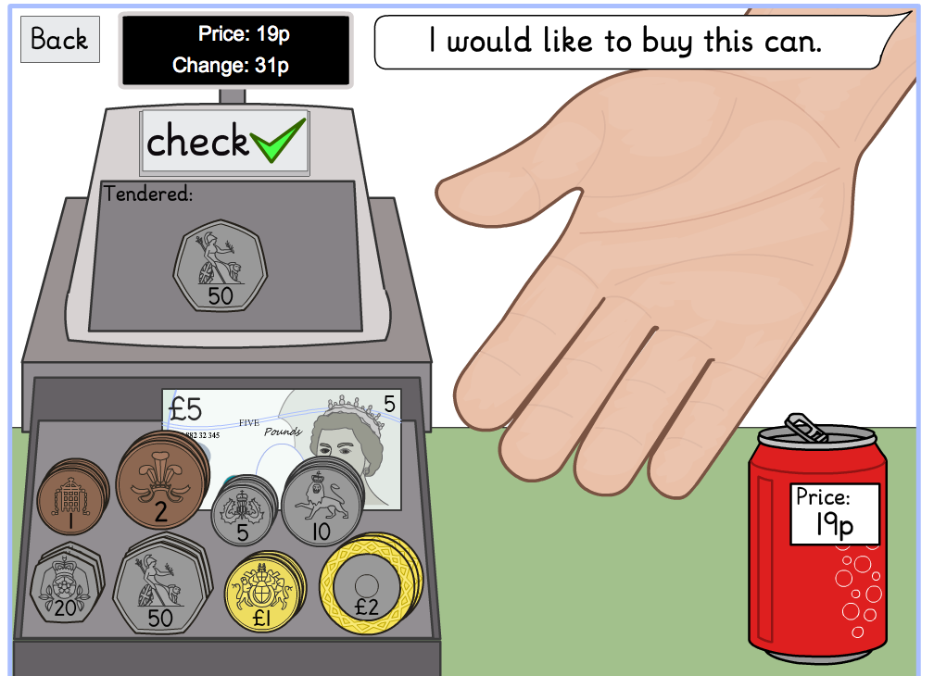
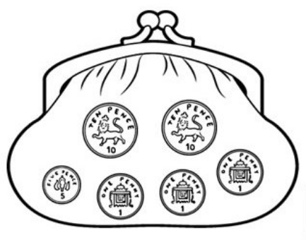
1 is a part and 4 is a part
What else do we teach in Maths?
Money
We look at the names of coins and notes. We recognise coins and notes and what the value is of each coin. We discuss how some coins are worth the same as another coin (eg. 1p + 1p = 2p).
We add up coins to find the total and in Year 2 we look at making change when we need to ‘buy’ something.

Slide 17
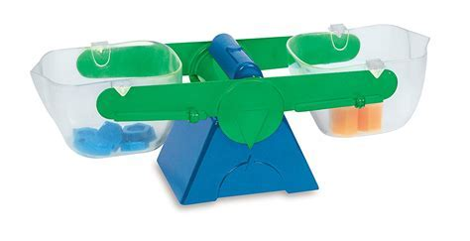
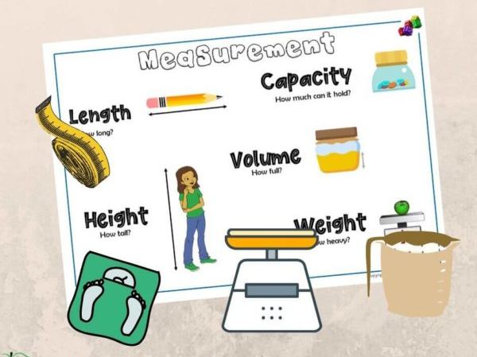
1 is a part and 4 is a part
What else do we teach in Maths?
Measurement
We discuss capacity, mass/weight and length/height.
We describe and solve practical problems and explore intervals in cm, m, ml, g and kg by using weighing scales, rulers and containers.
We sequence events in chronological order and use language relating to dates (days, months, years).

Slide 18
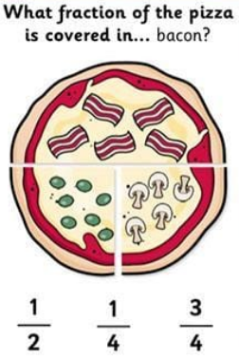
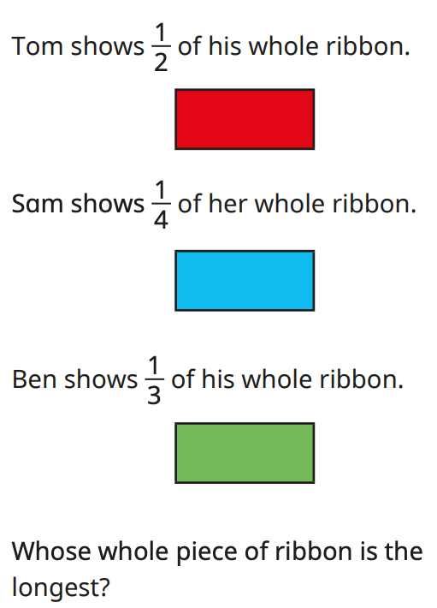
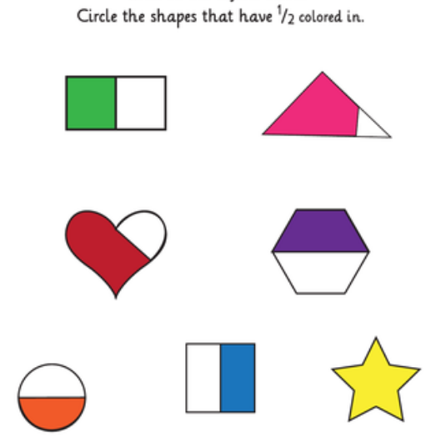
1 is a part and 4 is a part
What else do we teach in Maths?
Fractions
We recognise, find and name a half, as one of two equal parts.
We recognise, find and name a quarter as one of four equal parts.
We can recognise half of a quantity, half of a length or half of a shape.
We recognise and write 1/3, ½, 2/4, ¾ and write simple fraction equations eg. ½ of 6 = 3.

Slide 19
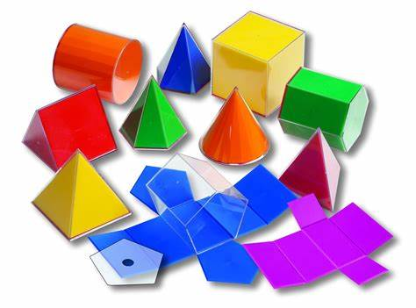
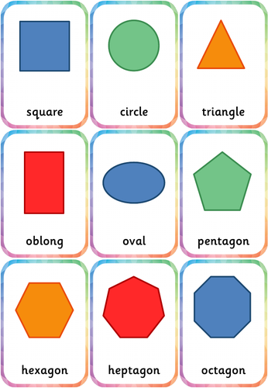
1 is a part and 4 is a part
What else do we teach in Maths?
Shape & Position and Direction
We identify the properties of 2D and 3D shapes – sides, corners, edges, faces.
We identify the 2D shapes within 3D shapes.
We compare and sort common shapes.
We order and arrange objects in patterns and sequences.
We use mathematical language to describe position and directions.
We describe turns by applying rotations.

Slide 20
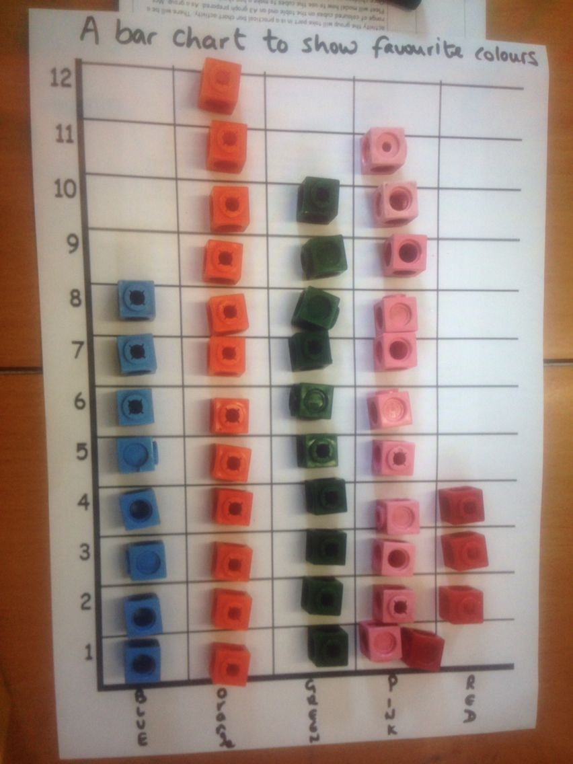
1 is a part and 4 is a part
What else do we teach in Maths?
Statistics (Year 2)
We interpret simple pictograms, tally charts and block diagrams. We ask and answer simple questions about these. We collage and compare information with simple ratios (2, 5, 10)

Slide 21
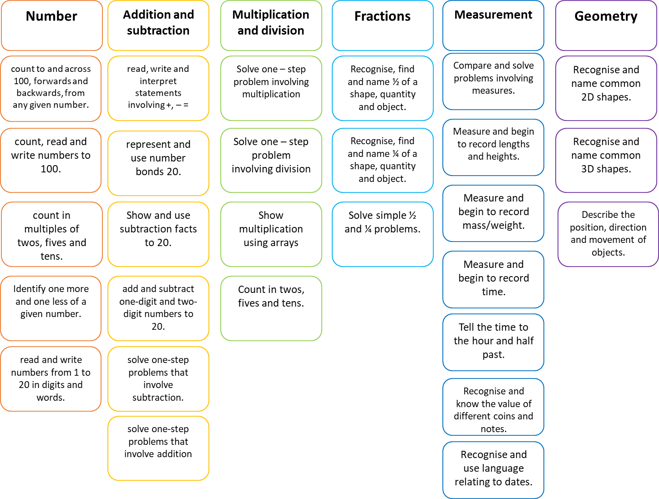
Th
End of Year One Expectations:

Slide 22
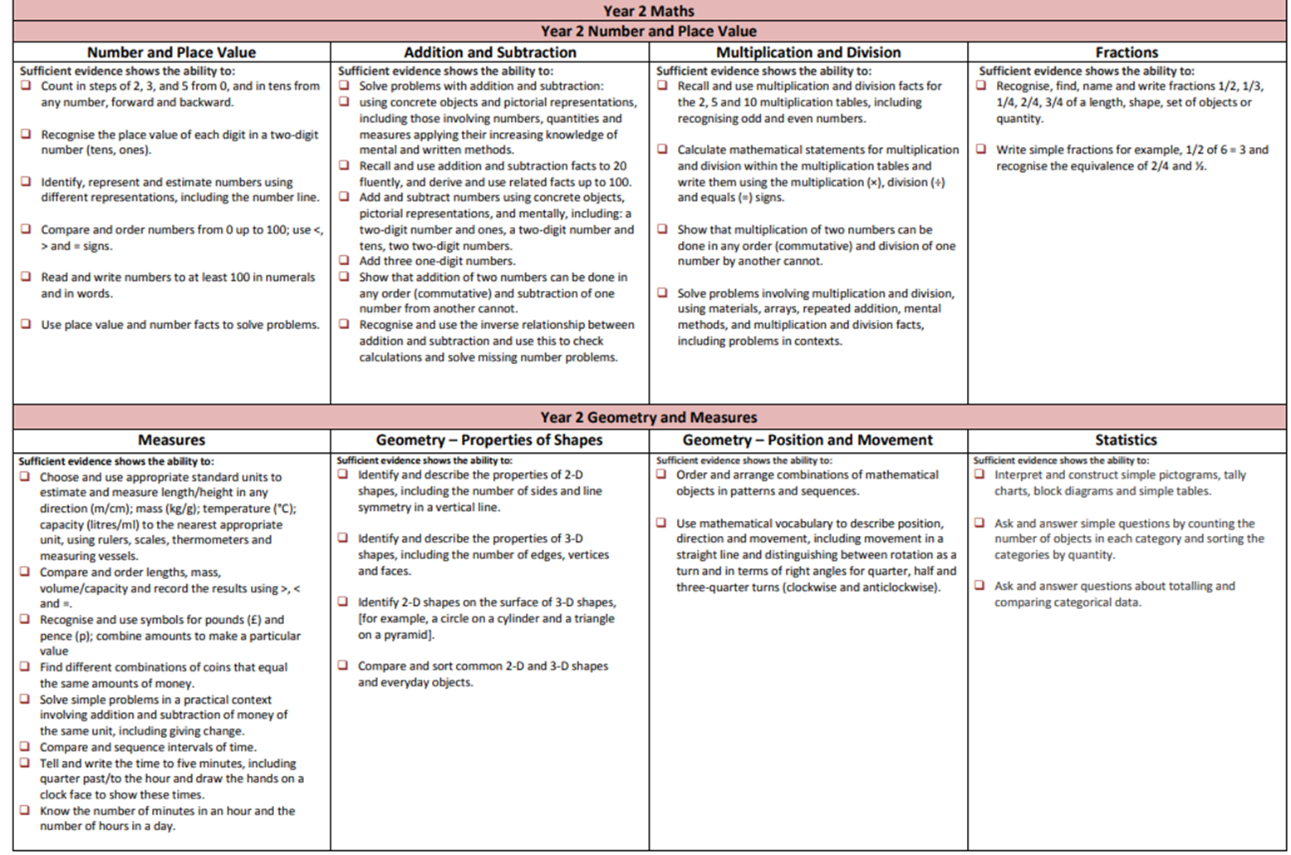
Th
End of Year Two Expectations:

Slide 23
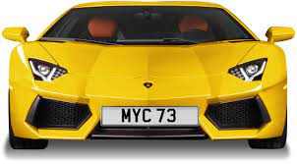
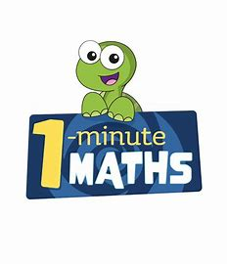
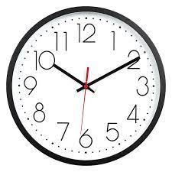
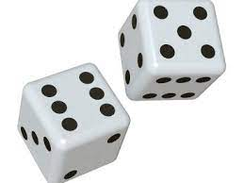
Ideas to support your child at home:
Finding number patterns.
Counting opportunities to secure 1:1 correspondence.
Subitising when playing games with a dice or anywhere at home.
Telling the time on an analogue clock.
Exploring fractions when cutting pizza, cake, fruit.
Practise exploring coins and working out the change.
Opportunities to weigh and measure when cooking!

Slide 24
Thank you

