Slide 1
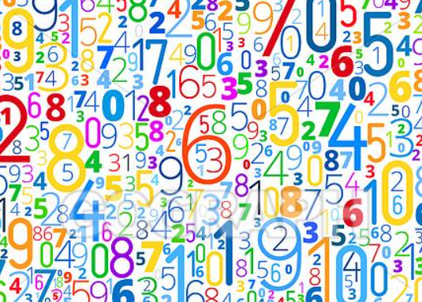
EYFS Maths Workshop
The Horsell Village School
November 2024

Slide 2
Th
The aims of this presentation are to share with you :
Our Intent.
The aims of the EYFS Curriculum.
Developing Number sense.
Developing other aspects of Maths.

Slide 3
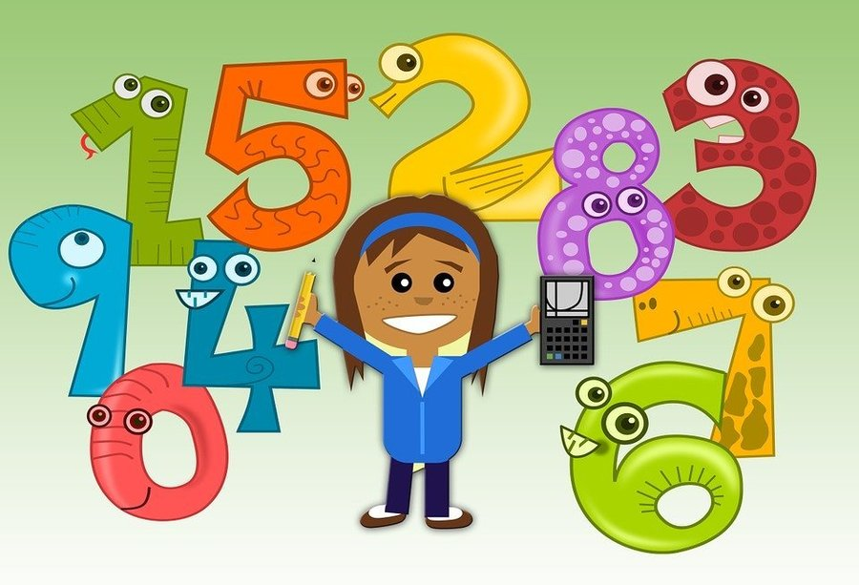
Th
Our Intent:
We ensure that the curriculum design allows for small secure steps and
acknowledges the importance of the children being secure and fluent in a
concept before moving on to the next level.
Pupils are required to explore and investigate Maths in depth, using mathematical vocabulary to reason and explain their workings.
A wide range of mathematical resources are used in lessons and pupils are taught to show their workings using concrete materials, before establishing ways of pictorially and formally representing their understanding.
We encourage children to respond positively to challenge, developing resilience in all aspects of maths learning as well as self-reflection in order to identify next steps in their learning.
There is a Number focus in day-to-day teaching and learning as we want pupils to develop confidence and mental fluency with whole numbers, counting and place value.

Slide 4
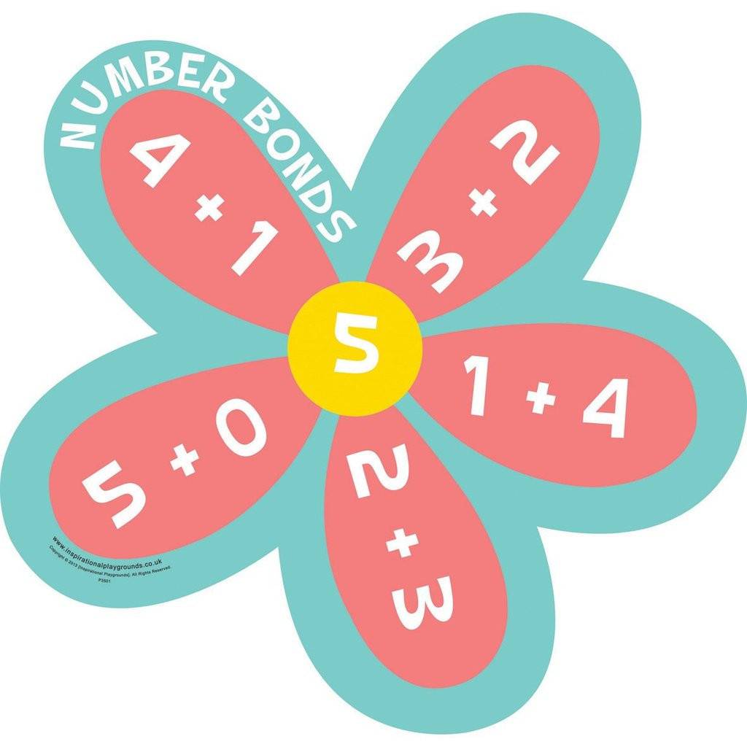
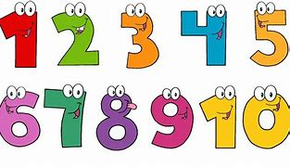
Th
EYFS Curriculum:
EYFS Statutory Educational Programme:
Developing a strong grounding in number is essential so that all children develop the necessary building blocks to excel mathematically. Children should be able to count confidently, develop a deep understanding of the numbers to 10, the relationships between them and the patterns within those numbers.

Slide 5
Th
End of Year Expectation:
Number
Early Learning Goal
Children at the expected level of development will:
Have a deep understanding of number to 10, including the composition of each number;
Subitise (recognise quantities without counting) up to 5;
Automatically recall (without reference to rhymes, counting or other aids) number bonds up to 5 (including subtraction facts) and some number bonds to 10, including double facts.
Numerical Patterns
Early Learning Goal
Children at the expected level of development will:
Verbally count beyond 20, recognising the pattern of the counting system;
Compare quantities up to 10 in different contexts, recognising when one quantity is greater than, less than or the same as the other quantity;
Explore and represent patterns within numbers up to 10, including evens and odds, double facts and how quantities can be distributed equally.

Slide 6
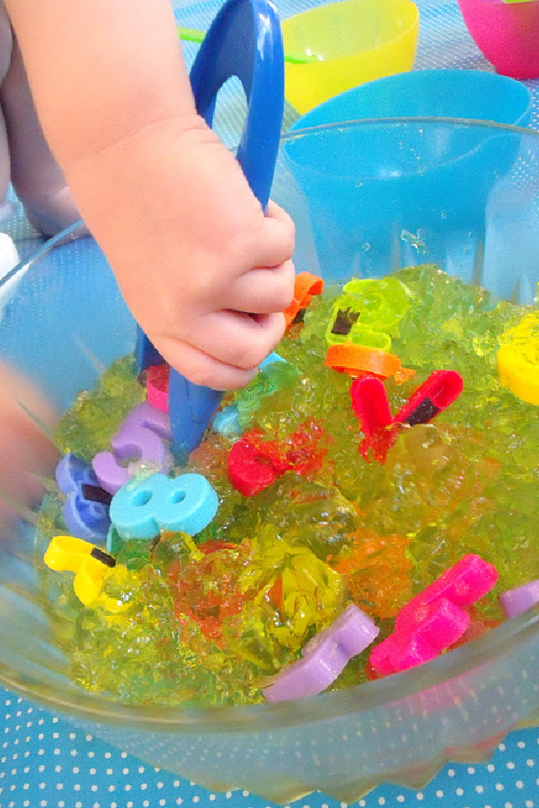
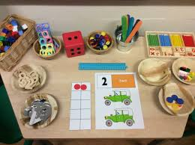
Th
In Reception the children will be learning to:
Count objects, actions and sounds.
Subitise.
Link the number symbol (numeral) with its cardinal number value.
Count beyond ten.
Compare numbers.
Understand the ‘one more than/one less than’ relationship between
consecutive numbers.
Explore the composition of numbers to 10.
Automatically recall number bonds for numbers 0–5 and some to 10.
Select, rotate and manipulate shapes to develop spatial reasoning skills.
Compose and decompose shapes so that children recognise a shape can have other shapes within it, just as numbers can.
Copy, continue and create repeating patterns.
Compare length, weight and capacity.

Slide 7
What do we do to help children?
Concrete
(Physical Objects)
Pictorial
(Drawings/Models)
Abstract
(Using numbers)
1
2
3
4
Concrete and pictorial
representations support
children to understand abstract
concepts and deepen
their knowledge.

Slide 8
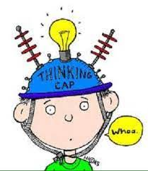
What is number sense?
So….. What is number sense and why is it so important?
Number sense refers to a child’s fluidity and flexibility with
numbers.
It helps children understand what numbers mean, increasing
mental mathematics and giving children the tools to look at maths in the outside world and make comparisons.
Number sense is the main focus in the Early Years Curriculum and forms an essential part of fluency for all year groups.

Slide 9
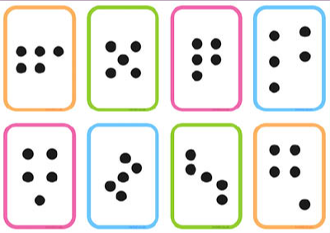
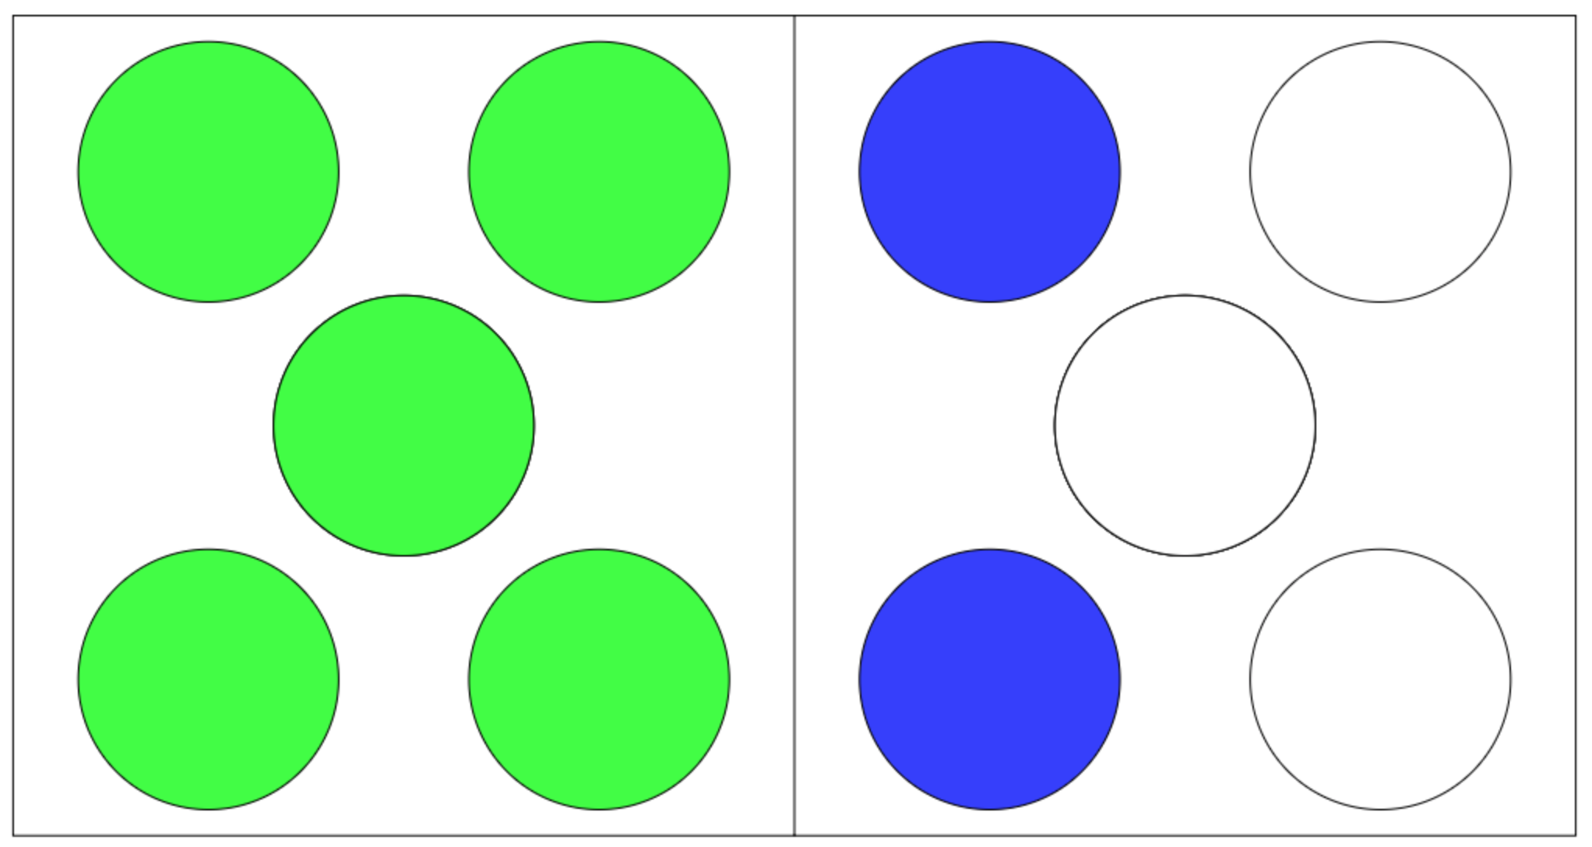
How do we help develop Number sense?
Subitising
Don’t count, say the amount.
Children need a variety of opportunities to see regular amounts of quantities and be encouraged to ‘say what they see.’
These regular amounts also need to be shown in irregular ways:
* conceptual subitising
(seeing smaller numbers)
* perceptual subitising
(seeing numbers straight away)

Slide 10
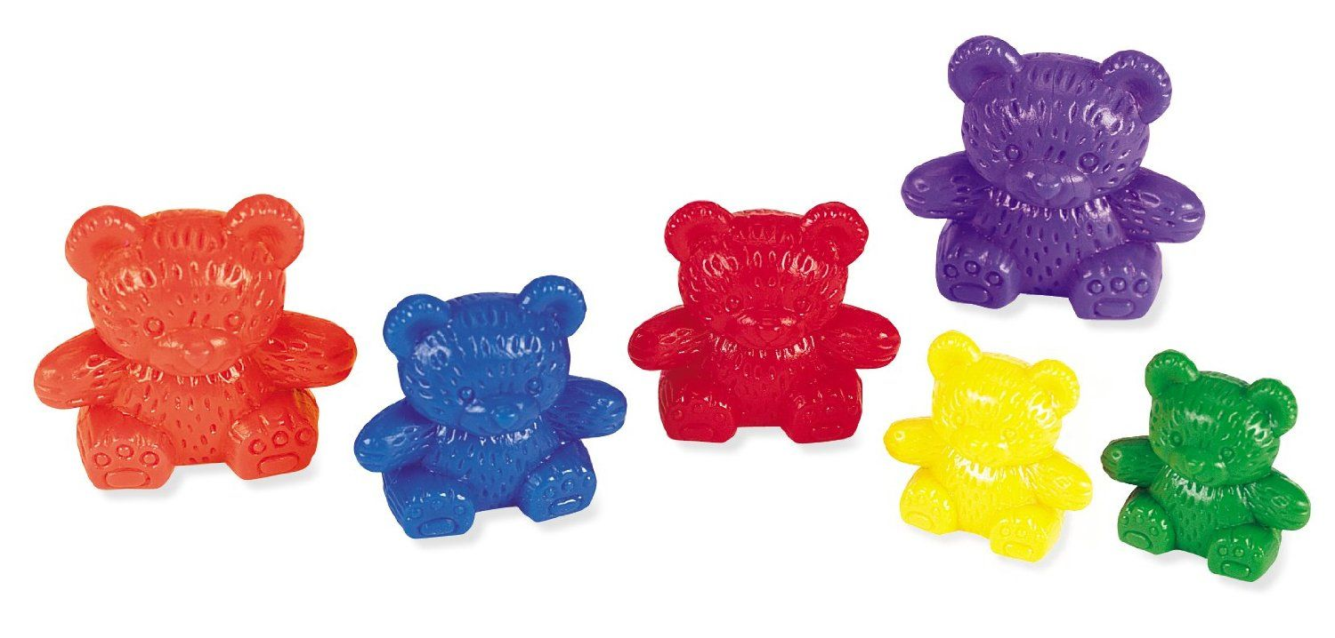
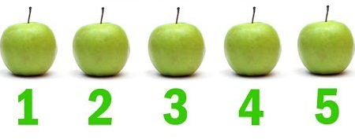
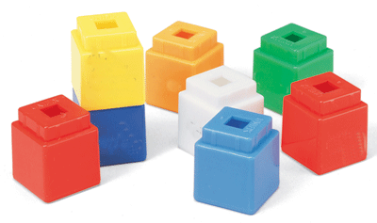
How do we help develop Number sense?
Counting
3 rules of counting
1.Count everything once
2. Say the numbers in the right order
3. The last number you say is how many there are
1:1 correspondence

Slide 11
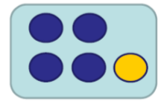
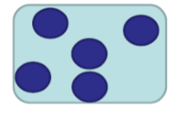
How do we help develop Number sense?
Cardinality
Cardinality means the quantity or total number of items in a set.
This can be determined by subitising or counting.
While subitising allows children to perceive the cardinality of small sets, counting requires them to understand that the last number in the counting sequence represents the quantity of the set. We refer to this as….
‘The 5-ness of 5’
Familiar dot patterns | Structured dot patterns | Unstructured dot patterns

Slide 12
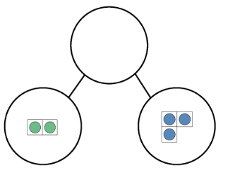
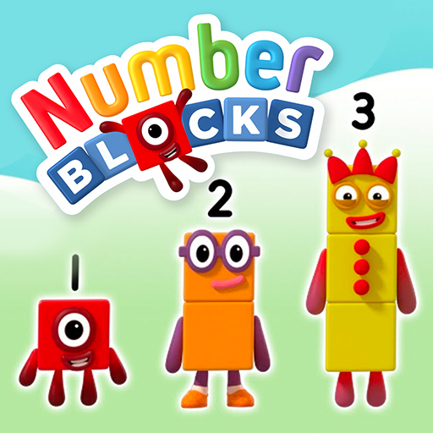
1 is a part and 4 is a part
How do we help develop Number sense?
Composition
Composition refers to knowing numbers are made up of two or more smaller numbers.
For example
. 5 is the whole
2 is a part and 3 is a part
4 is a part and 1 is a part
5 is the whole
Being able to see numbers within numbers helps to develop efficient calculating skils.
The program ‘Number blocks’
focuses on the concept of
Composition.

Slide 13
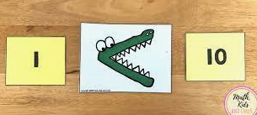
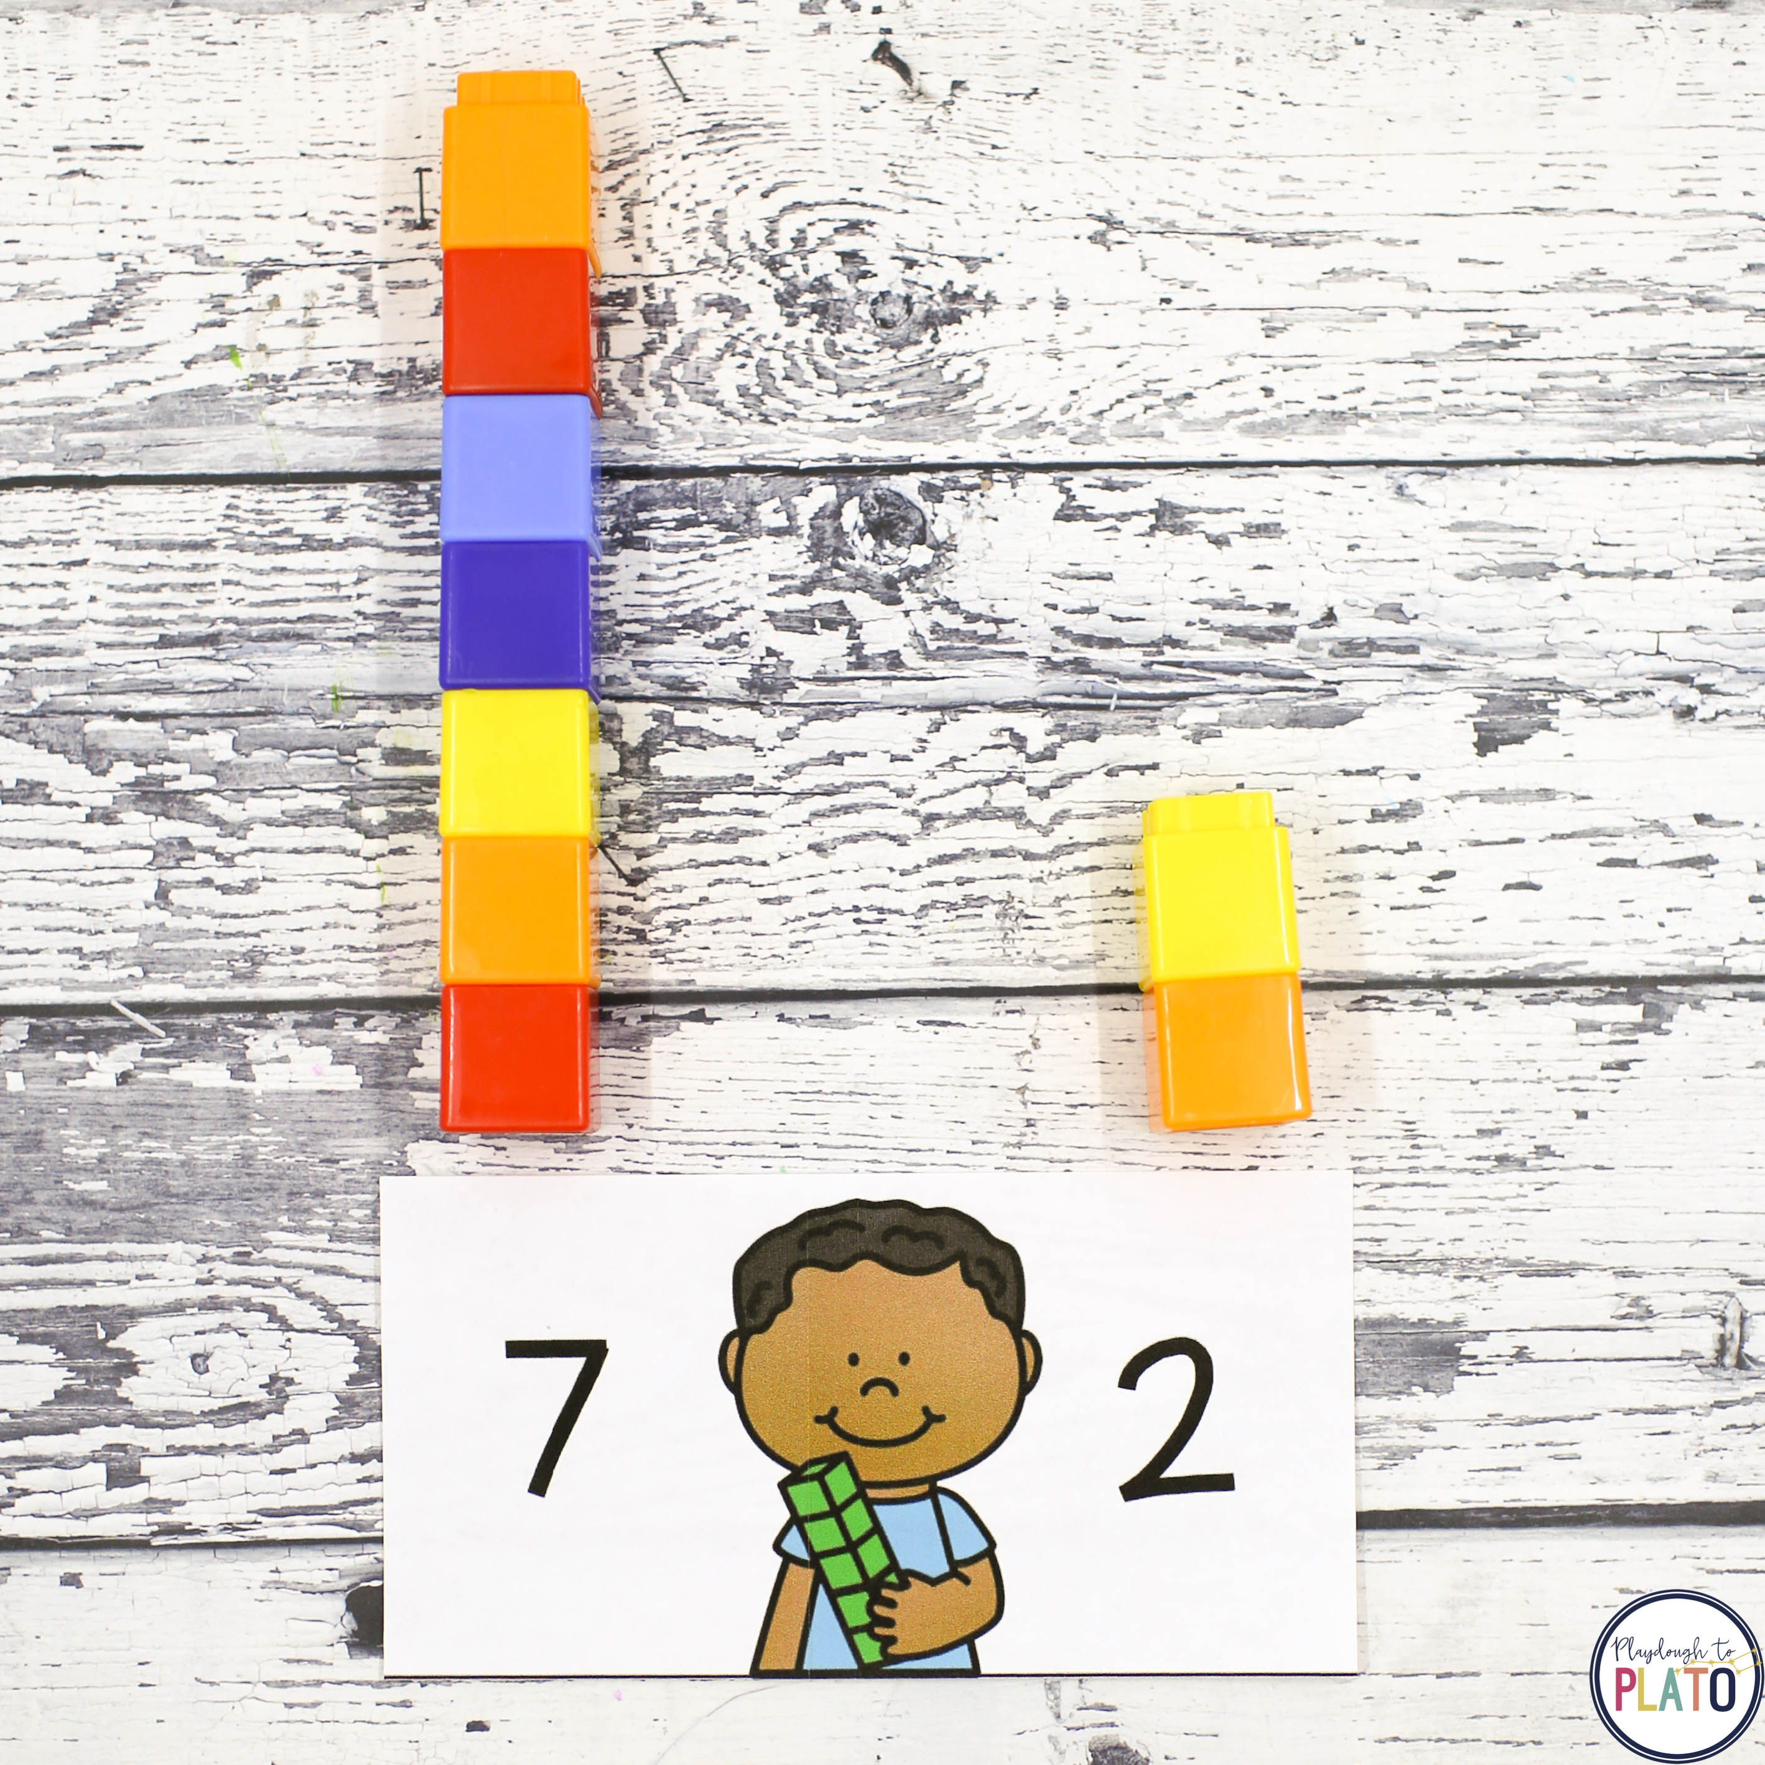
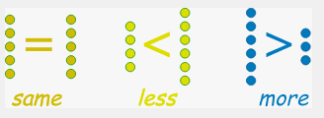
1 is a part and 4 is a part
How do we help develop Number sense?
Comparison
When we ask children to compare numbers we are asking them to examine the difference, to decide if one number is greater than, smaller than or equal to another number. This understanding underpins the mental number line which children will develop later. E.g. How much bigger or smaller they are than each other.

Slide 14
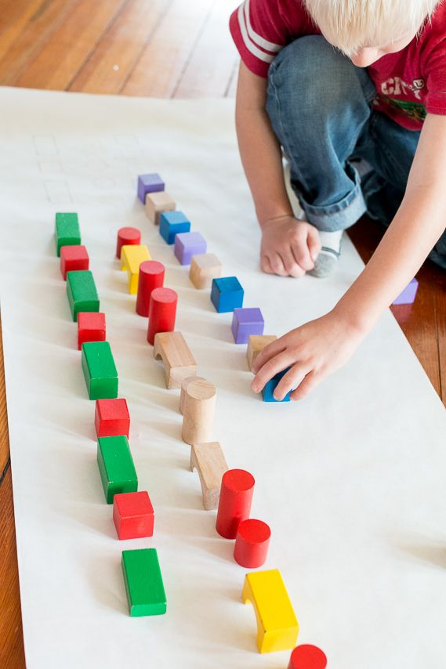
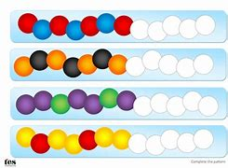
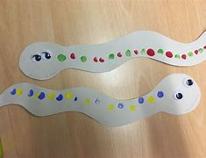
1 is a part and 4 is a part
What else do we cover in EYFS?
Pattern
Developing an awareness of pattern helps young children to notice and understand mathematical relationships.
We begin by continuing an AB pattern, copying an AB pattern and then
developing our own AB patterns. We can then progress into ABB ABC ABBC patterns.

Slide 15
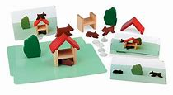
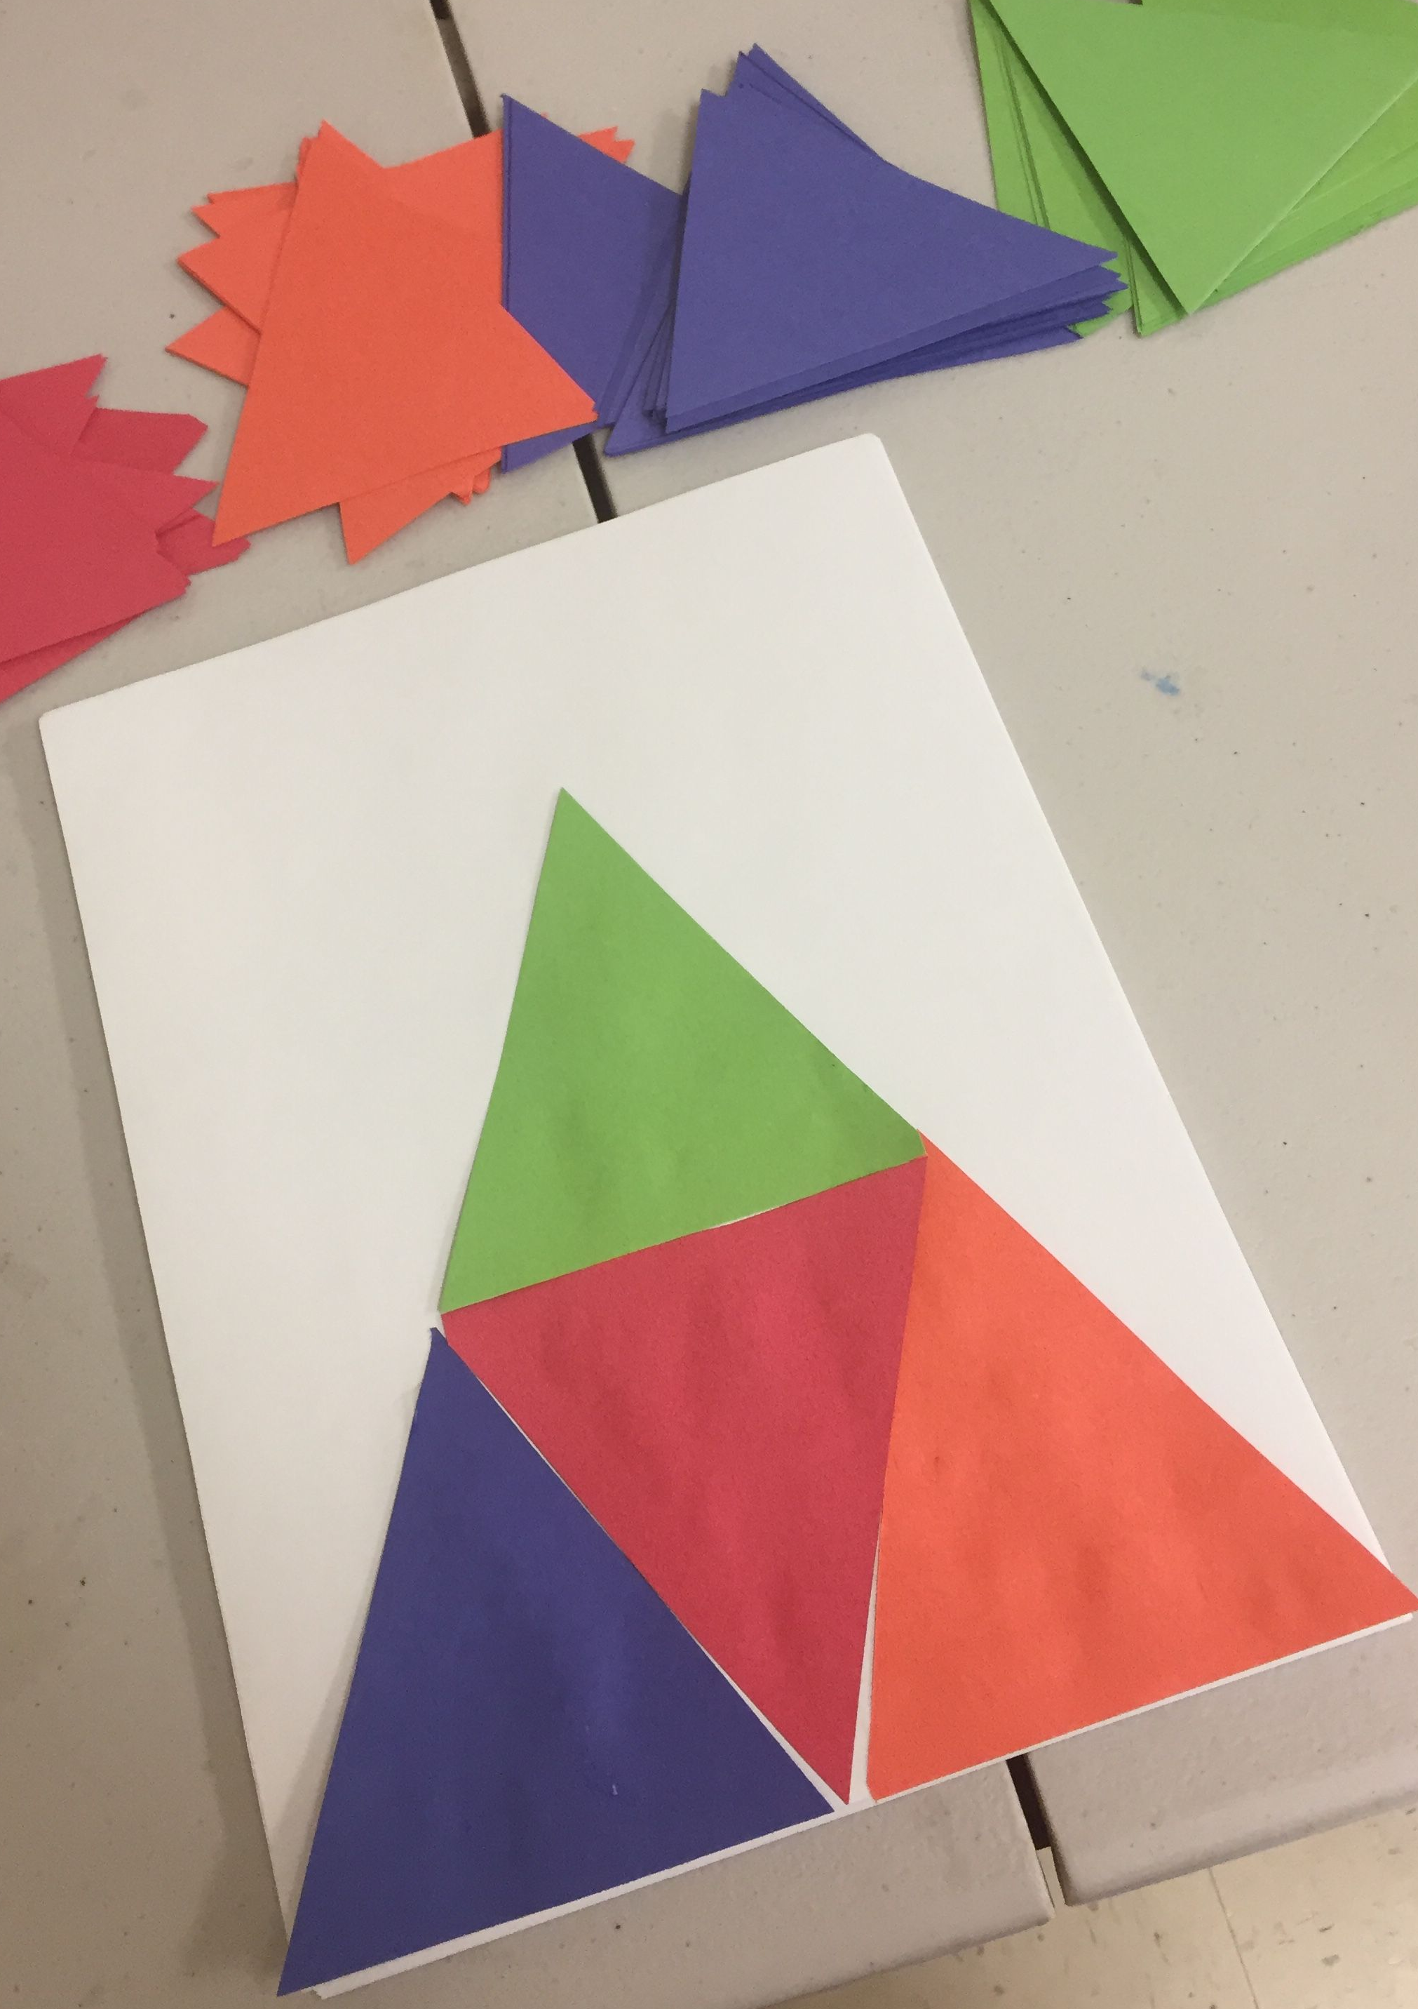
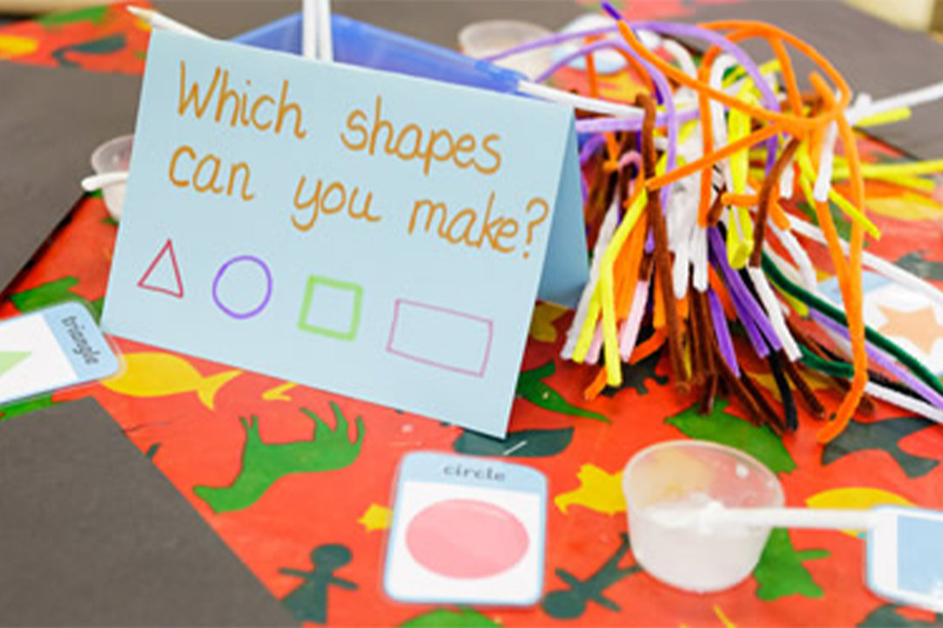
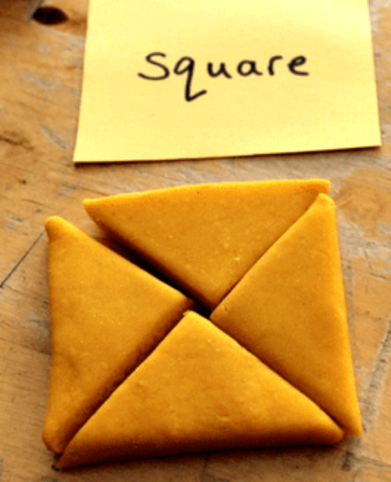
1 is a part and 4 is a part
Shape and Space
Shape and space in EYFS is about developing visualising skills - understanding what happens when shapes move or combine with other shapes.

Slide 16
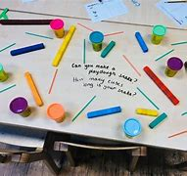
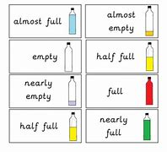
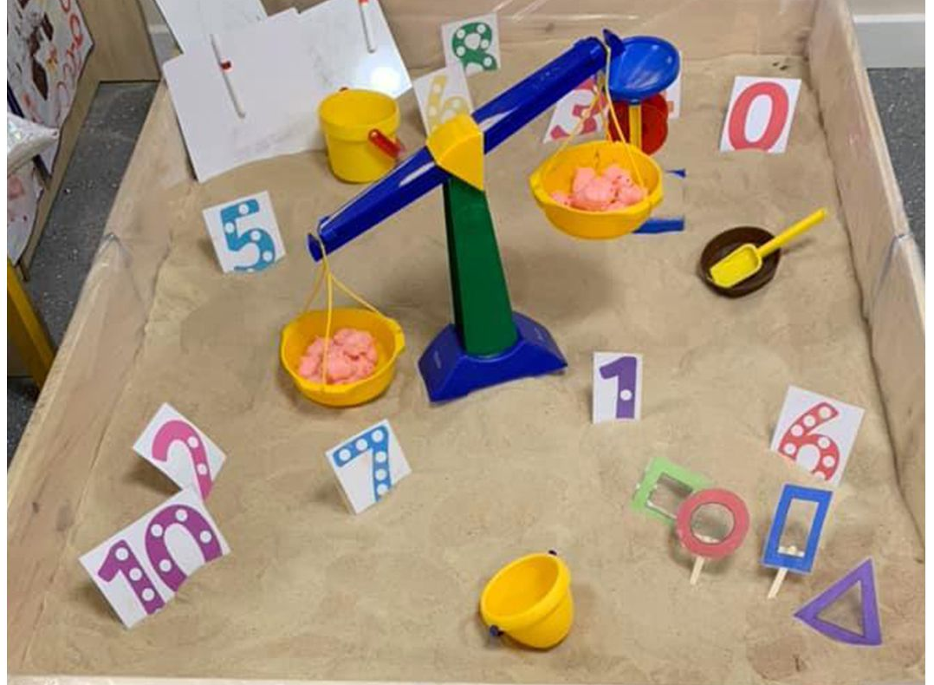
1 is a part and 4 is a part
Measures
First, we need to decide which attribute is being measured - length, capacity, weight.
Can children find something that is longer/shorter or heavier/lighter than a given item?
After lots of practical experience with comparing items, children can then begin to estimate and predict.

Slide 17
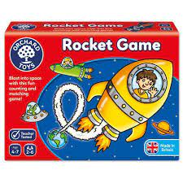
What can you
do at home?

Slide 18
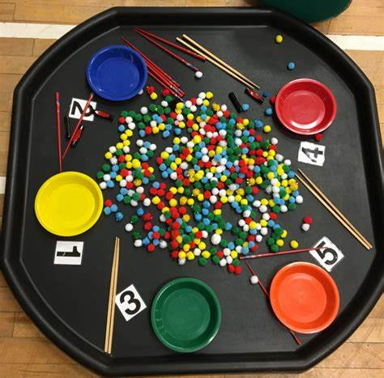
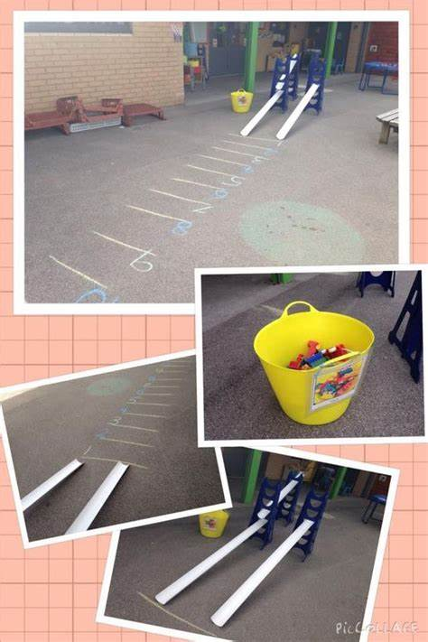
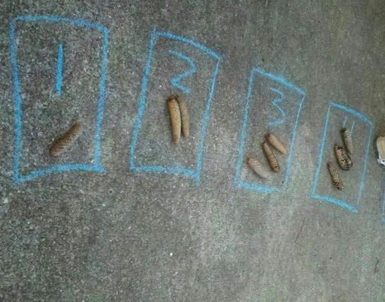
Thank you for your time.
We hope you found this
presentation helpful.

