Slide 1


Behaviour and Emotion Coaching
The Horsell Village School

Slide 2


“
When children are struggling, they need support, not red lines and stern faces. They don't need the dark suits of doom, but rather a coach, detached from any process, to support, mentor and guide. A skilled, empathetic adult who can work with the child to meet their immediate needs and stem the flow of poor conduct.
Paul Dix
When the Adults Change, Everything Changes; Seismic Shifts in School Behaviour

Slide 3
What is Emotion Coaching?
A universal approach to support children and young people to understand and manage their feelings
‘Emotion Coaching helps children and young people to understand the different emotions they experience, why they occur and how to handle them’
Gottman (1996)
Key elements: empathy and guidance
Key summary phrase: “Connect before correct”

Slide 4
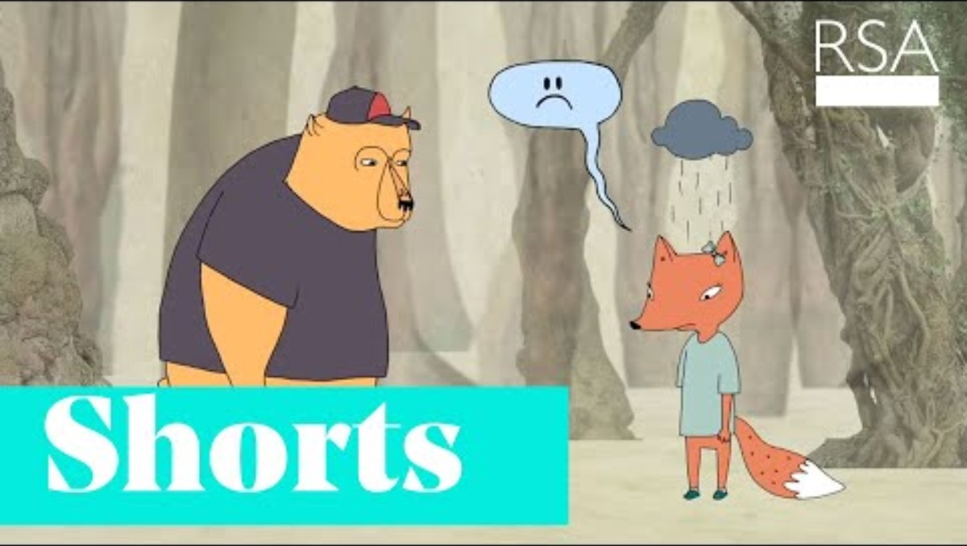

Slide 5
Why Do Emotion Coaching?
Emotion Coaching is an evidence-based strategy based upon the work of John Gottman and the brain science of Daniel Siegel.
It is compatible with existing school strategies, and we all already provide empathy and guidance to children and young people.
Emotion coaching aims to help children:
control their impulses
delay gratification
self soothe when upset
pay attention

Slide 6
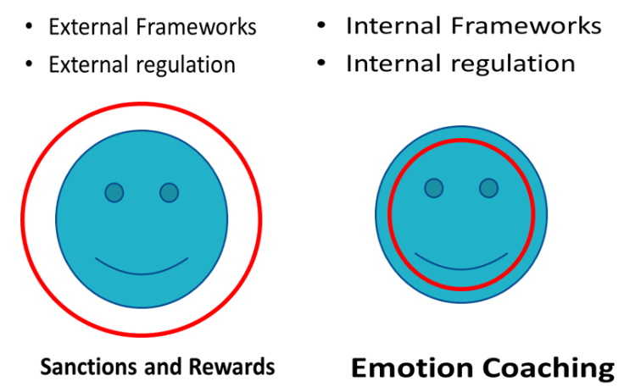
Why do Emotion Coaching?
Emotion Coaching gives strategies to deal with the ups and downs in school and in life.
It uses moments of negative behaviour as opportunities for teaching.
It builds trusting and respectful relationships.
It accepts that all emotions are normal.
It also supports the development of internal regulation.

Slide 7
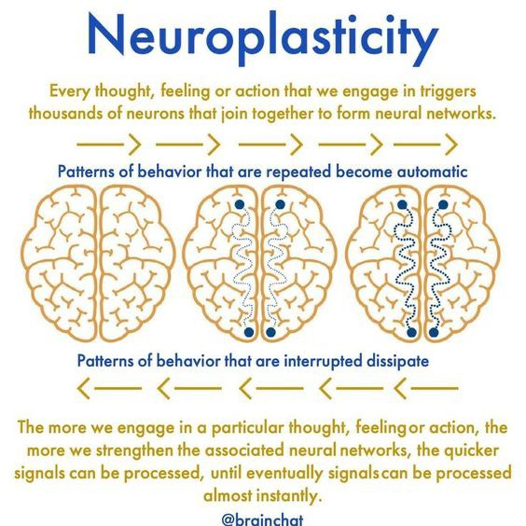
Why Emotion Coaching?
Through the use of Emotion Coaching we also:
Create and promote adult and child relationships that are built on trust.
We become more sensitive to children's needs.
We reduce behaviour incidents and exclusion.
We lead by example and demonstrate consistency.
Change can happen!
Repeated positive experiences lead to stronger connections that support emotional regulation.

Slide 8
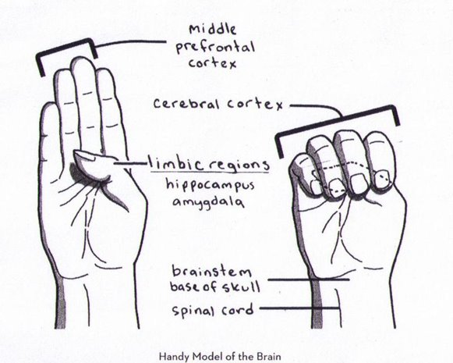
A Brain in the Palm of your Hand
Think of an example when someone you work with (child or adult) has ‘flipped their lid’.
What worked in helping them to calm down?

Slide 9
When and how can we use it?
Step 1​​
Recognising the child’s feelings and empathising with them​​
​​
Step 2 ​​
Validating the feelings and labelling them​​
Step 3​​
Setting limits on behaviour (if needed)​​
​​
Step 4 ​​
Problem-solve with the child
Emotion Coaching should be use 60% of the time.
It might not work in every situation but give it a go.

Slide 10
Step 1
Need to genuinely empathise with the child/young person from their point of view. This doesn’t mean agreeing with them, just viewing things from their perspective​
Recognise all emotions as being natural and normal and not always a matter of choice​
Recognise behaviour as communication (relational vs behavioural model)​
Look for physical and verbal signs of the emotion being felt​
Take on the child/young person’s perspective (mentalising/mind-mindedness)
Recognising the child’s feelings and empathising with them.
“Connect before Correct”

Slide 11
Step 2
Use words to reflect back child’s emotion and help child to label emotion
Simply observe – saying what you see rather than asking probing questions to which young people might not know answer
Echo their words, if that’s helpful.
Telling the emotional person that you understand their emotional situation and that you don’t blame them helps sooth their emotional brain
Validating the feelings and labelling them

Slide 12
Coaching Scripts
‘I can see that you get angry when that happens. I would feel angry if that happened to me. It’s normal to feel like that’
‘I can see you’re frowning and you’re kicking the wall and you’re expressing a lot of energy. I would be feeling like that too if I didn’t want to do something’
‘I noticed you are looking around at the other who are working on their projects. I think you might be feeling nervous right now about whether your work will be ok. Have I got that right?’
Examples

Slide 13
Step 3
Examples
‘These are the rules that we have to follow . Doing that is not ok’.
‘You didn’t do the task as we agreed. You’re probably angry that you can’t join in the practical session with the others now because you must complete the written assessment first’
‘We can’t behave like that even though you are feeling annoyed because it is not safe’.
Setting Limits
(if needed)
Validate the emotion and label the feeling
…BUT…
certain behaviours cannot be accepted.
‘You are angry that I’ve taken away your phone, but these are the rules everyone has to follow. I will keep it safe for you’

Slide 14
Step 4
Exploration of the incident/behaviour and scaffolding
(suggesting/supporting) ideas and actions that could lead to a more productive outcome.
Problem solving supports moving from emotions to thinking.
Problem solving with the child

Slide 15
Step 4
‘This is not a safe place to be angry. Let’s go to a safe place and then we can talk’
‘Next time you’re feeling like this, what could you do? How do you think you will react next time or if this happens again’
‘You need to work in a group with Ruth or work with me - which do you want to do?
Examples

Slide 16
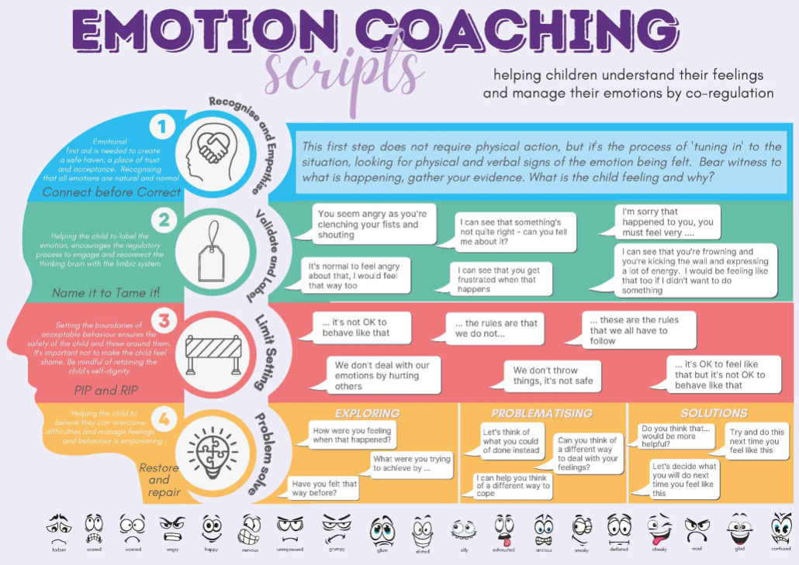
Have a read of the scripts. Can you think of an occasion recently where this could have been useful.
What could you have responded differently and why?
Share with a partner.

Slide 17
Video
Identify the Emotion Coach.
Which character is emotion coaching and which is
Not?
Which is which? How do you know? What are the results?

Slide 18


Slide 19

Final Thoughts and Questions What will you take forward from this and why?

